Slide 1
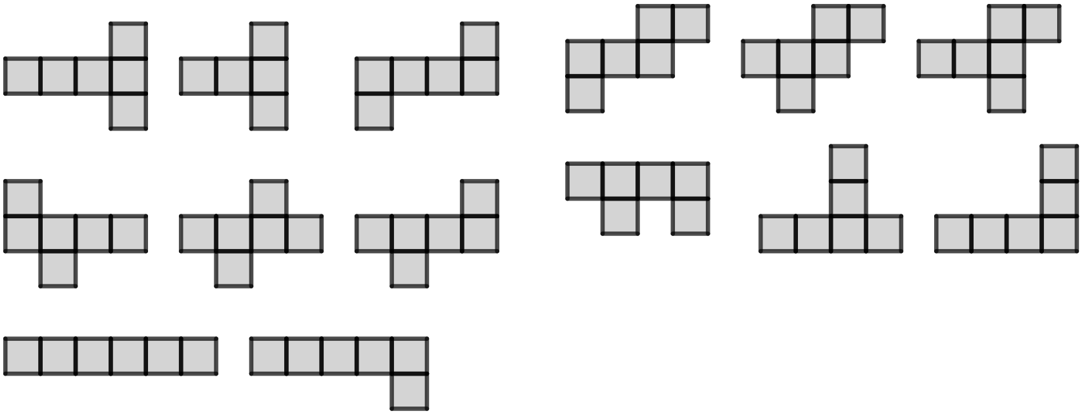
Surface area of cuboids
Task A: Nets of cuboids
1) Groups are either: all nets that can fold up into cubes, or all composite shapes that won’t fold up into cubes.
a) Can you spot any patterns or similarities with each of the shapes in a group?
b) Which groups can fold up into cubes, and which can’t?
A
1
A
2
A
3
B
1
B
2
B
3
C
1
C
2
D
1
D
2
D
3
E
1
E
2
E
3
c) Can you come up with any potential rules for arrangements of 6 squares that definitely are or definitely are not nets of cubes?
d) There is one unique net (not a rotation or reflection of one in a group) that isn’t given. Can you draw this missing net and fold it up into a cube to check?

Slide 2
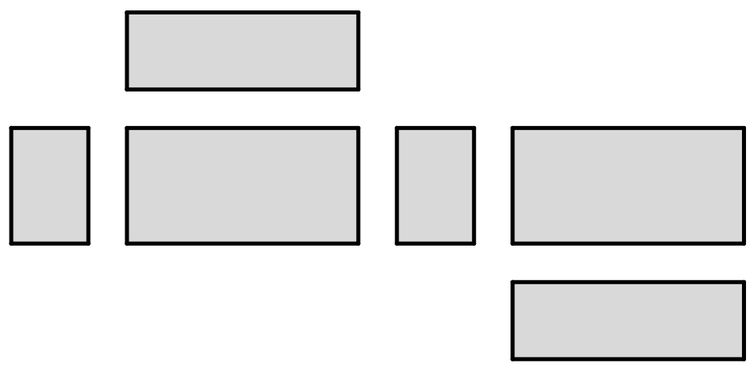

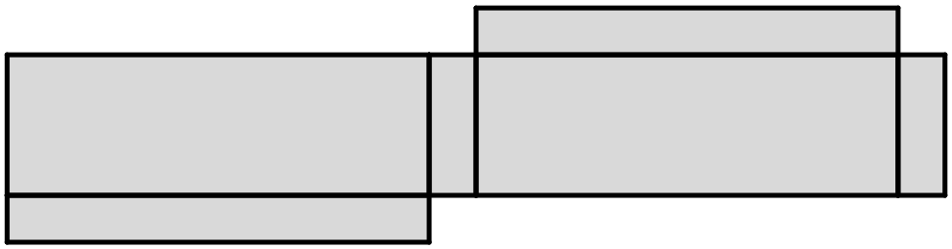
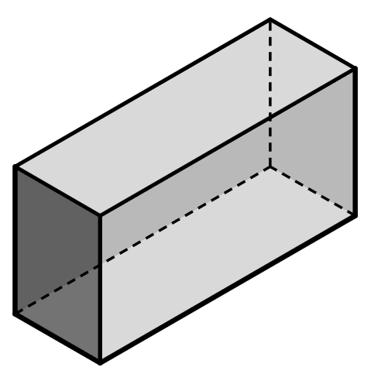
Surface area of cuboids
Task B: Surface area of cuboids from nets
1) These six rectangles can be connected to create the net of a cuboid.
6 units
c
a) Calculate the area of the three rectangles labelled a, b, c.
a
b
10 units
b) The three remaining rectangles have the same areas as in part a. Write the correct area on the corresponding rectangle.
6 units
14 units
c) Hence, find the surface area of the cuboid.
2) By finding the area of at least three rectangles, complete the calculation to find the surface area of the cuboid which would be made from this net.
15 cm
8 cm
8 cm
25 cm
2( + + ) = cm²
the surface area of this cuboid is:
Task C: Surface area of cuboids from 3D representations
1) Complete the calculations to find the surface area of this cuboid.
front = 2 × = .
back = .
5 cm
right = × = .
left = .
11 cm
bottom = 2 × 11 = .
2 cm
top = .
surface area = .
v2.3

Slide 3
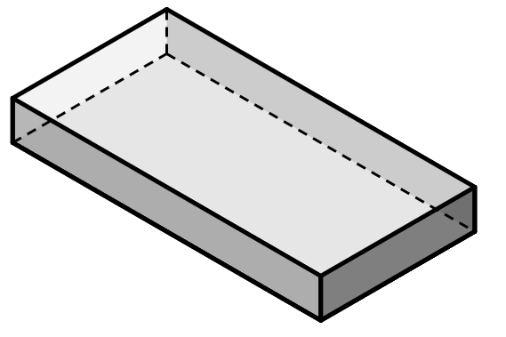
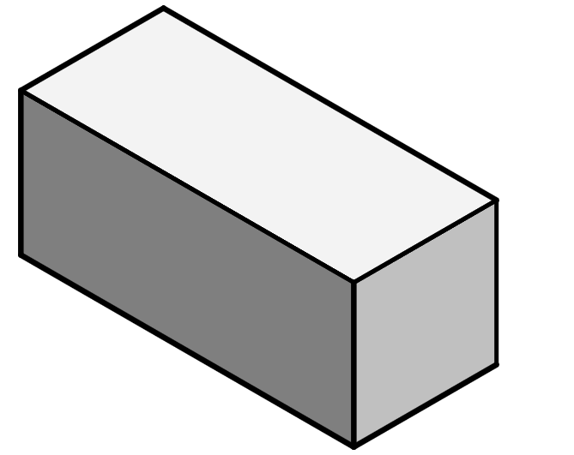
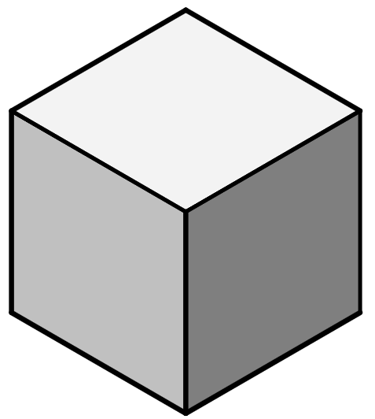
Surface area of cuboids
2) Complete the calculations to find the surface area of this cuboid.
front and back
30 × 4 × 2 = .
left and right
× × 2 = .
4 m
top and bottom
30 × × = .
30 m
12 m
surface area = + + = .
3) Complete the calculations to find the surface area of this cuboid.
front = .
right = .
top = .
surface area = 2 ( + + ) = .
7 inches
16 inches
8 inches
4) This is a cube.
a) Calculate the area of the front, right, and top faces of the cube, and hence calculate the surface area.
front = .
right = .
top = .
surface area = 2 ( + + ) = .
5 m
b) Jun says there is a quicker way of calculating the surface area of a cube. Is Jun correct? If so, show a more efficient calculation to find the surface area of a cube.
Mathematics in Education and Industry.

